Slide 1
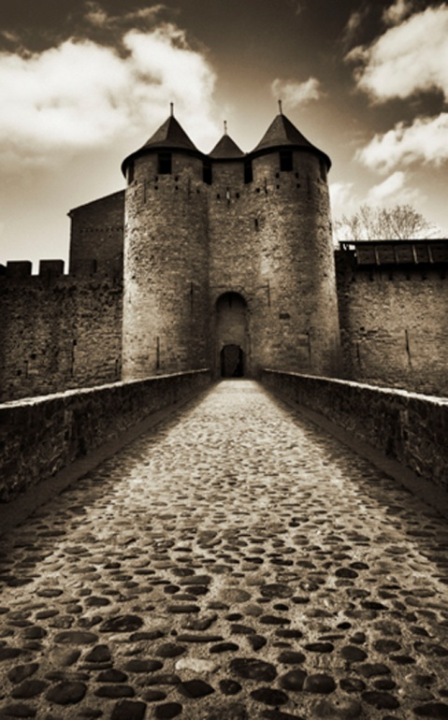
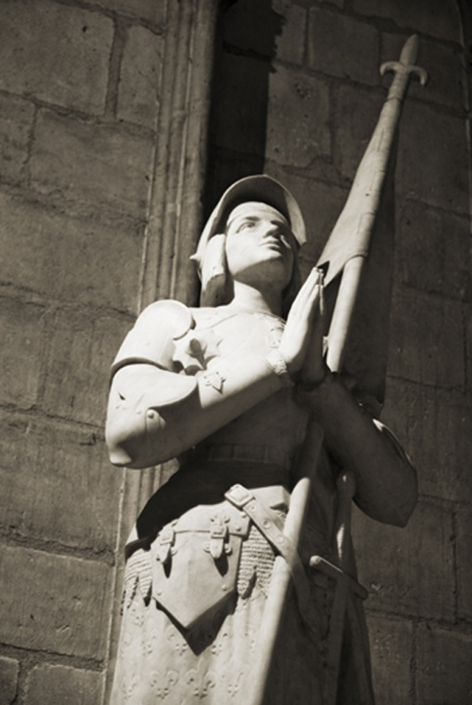
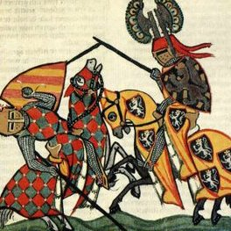
Middle Ages

Slide 2
Middle Ages
Often called Medieval times
Anglo Saxon time period– 449 to 1066
Middle Ages-1066-1485

Slide 3
Fall of Rome / Middle Ages
In 476 C.E., warriors attacked the city of Rome
Fall of the Roman Empire marked as the end of ancient history. The next 1000 years were called the Middle Ages.
The beginning of the Middle Ages is often called the Dark Ages
Notes:
Because Rome had fallen and life in Europe was hard. Very few could read and write, and no one expected conditions to improve. The only hope for most was their belief in Christianity, and the hope that life in heaven would be better than life on earth.

Slide 4
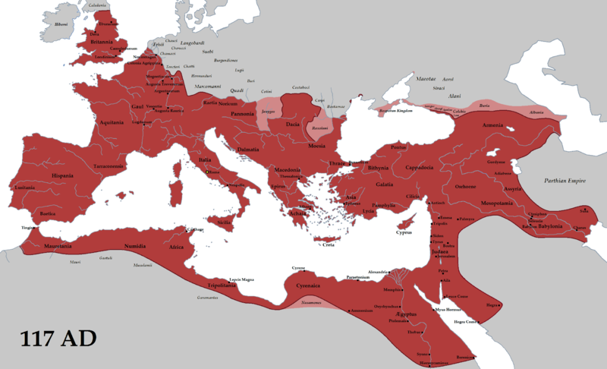
The Roman Empire
(in red)
Notes:
So expanded…no solidarity..too many rulers and not enough power against neighboring attackers who were stronger.

Slide 5
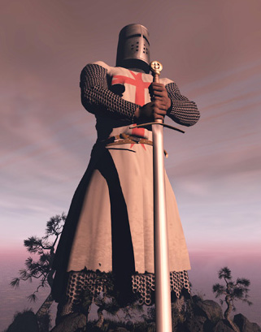
What is a Knight?

Slide 6
What is a Knight?
Almost all nobles were knights
Training began at age 7, as a page, under the guidance of the lady of the manor
Became squires at age 15 and were trained by other knights
Those deemed worthy were “dubbed” knights
Followed code of chivalry
Notes:
Almost all nobles were knights
Society made up of three groups – nobles, clergy and peasants
and townspeople
Knight’s training:
Began at age 7 as a page
Under guidance of the lady of the manor
- Taught courtly manners, sometimes reading, music, dancing – all
the necessities of a noble
- Ran errands and served her in return
Also began serving the knights performing simple tasks
Became a squire at age 15 and placed under guidance of a knight
- Taught the skills of knighthood, especially horsemanship and combat skills.
- Followed knight into battle and helped him if he was wounded or fell off his horse
If proven to be a good fighter he was rewarded by being made a knight
- Special ceremony known as dubbing
Knights were expected to follow certain rules known as the code of chivalry (politeness/courtesy)
Knights trained for war by fighting each other in tournaments
Most popular form of entertainment during the Middle Ages
Popular event was joust

Slide 7
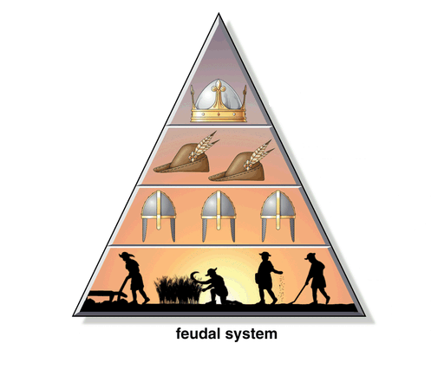
Feudal Society

Slide 8
WHY WAS FEUDALISM NECESSARY?
Notes:
After the Roman Empire collapsed, Europe had no strong central govt.
Cities were much smaller and were no longer economic cities but places to huddle for protection.
Roman nobles needed to protect their estates but had no money to pay soldiers
Former Roman generals and their soldiers were offered land in return for their assistance in protecting the estates.
Former tenant farmers and slaves of Rome became the peasants who worked for the landed upper class in return for a protected place to live.
Some small landowners willing gave up their land to the nobles in order to have a safe haven.
Nobles who had the land also had the political power.
He made all the laws for his fief

Slide 9
Feudal Society Necessary
After Roman Empire collapsed, Europe had no strong central government
Nobles needed people to protect estates

Slide 10
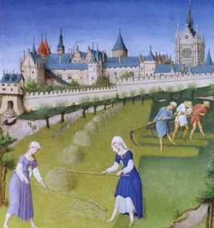
Serfs and Village Life
-

Slide 11
Workers on the Manor
There were two groups of peasant workers on the manor
Freemen- skilled workers who paid rent and could leave the manor whenever they wished. (They usually had a skill needed by others on the manor.)
Serfs – workers bound to the land by contract with the nobles. (They had no freedom - they where the noble’s property.)
Notes:
There were two groups of workers on the manor
Freemen:
Usually had a skill needed by others on the manor
Included seneschals and bailiffs who helped run the manor
- Seneschals looked after fiefs
by visiting each regularly
- Bailif made sure peasants
worked
- Towns (called shires) also had
peace-keepers known as
reeves
Serfs:
Required to work the noble’s land
Also worked their own land and gave a part of their crops to the noble
Had no freedom – they were the noble’s property
Peasants had no political power

Slide 12
Relationship Between Lords and Vassals
The relationship between lords and vassals made up a big part of the political and social structure of the feudal system
Vassals had certain duties to perform for the lord
All nobles were ultimately vassals of the king.
Notes:
The relationship between lords and vassals made up a big part of the political and social structure of the feudal system.
Based on ties of loyalty and duty among nobles
Nobles were both lords and vassals
Ties were made official by the “act of homage”
Fiefs were given to vassals by lords
Lords gave vassals the right to govern the people who lived on their fiefs
Lords promised to give protection to the vassals
Breaking the feudal contract could mean loss of land
Vassals had certain duties to perform for the lord.
Helped the lord in battle
Participated personally in military service 40 – 60 days a year
Gave money when the lord’s daughters married and when sons were knighted
Paid the lord’s ransom or took his place if he was captured
Attended the lord’s court
Provided food and entertainment when the lord visited
All nobles were ultimately vassals of the king.
Nobles provided the king with knights to form an army for defense and conquest
Because of this, the real power belonged to the nobles.

Slide 13
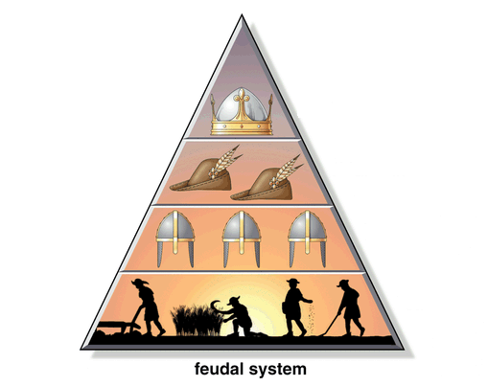
CONSTRUCTING THE
PYRAMID OR POWER
Notes:
Hierarchical system in which every man is another man’s vassal (or servant)
hardly any movement at all through the system in early MA
A bit more movement in high and late MA

Slide 14
CONSTRUCTING THE PYRAMID OF POWER
The lowest level of Feudal Society was made up of Serfs and Freemen.
In return for their labor, they received protection from the Lords/King.
SERFS AND FREEMEN

Slide 15
CONSTRUCTING THE PYRAMID OF POWER
The next level of Feudal Society was made up of Knights and Nobles.
In return for their loyalty and military service, they received land and protection.
LESSER NOBLES
(KNIGHTS)
LABOR
PROTECTION
SERFS AND FREEMEN

Slide 16
CONSTRUCTING THE PYRAMID OF POWER
The next level of Feudal Society was made up of Powerful Nobles.
In return for their loyalty and service, they received land.
POWERFUL
NOBLES
LOYALTY AND
MILITARY SERVICE
LAND AND
PROTECTION
LESSER NOBLES
(KNIGHTS)
LABOR
PROTECTION
SERFS AND FREEMEN

Slide 17
CONSTRUCTING THE PYRAMID OF POWER
KING
LOYALTY AND
SERVICE
LAND
POWERFUL
NOBLES/LORDS
LOYALTY AND
MILITARY SERVICE
LAND AND
PROTECTION
LESSER NOBLES
(KNIGHTS)
LABOR
PROTECTION
SERFS AND FREEMEN

Slide 18
Some Important Historical Events:
1066 Norman Conquest
-Old English + Old French=Middle English
Domesday Book
-land register& tax records
Crusades
Plague
Notes:
William the conqueror invaded England bringing old French Language. Old English merged with Old French=Middle English
Domesday-Census, land register, and income record to create a tax roll
Crusades-Against muslim turks headed by Pope Urban II. Said if you died fighting in crusades you would go to heavent
Plague-dirt

Slide 19

Plague/Black Death:
Took out 54 million
1/3 of population wiped out
Defining event(s) of the Middle Ages
Spread by fleas which lived on rats
A lack of cleanliness added to their vulnerability: crowded with poor sanitation; ate stale or diseased meat; primitive medicine (people were often advised to not bathe b/c open skin pores might let in the disease).
Highly contagious disease nodules would burst around the area of the flea bite.
Ring around the Posie
Notes:
Lack of medical knowledge meant that people tried anything to help them escape the disease. One of the more extreme was the flagellants. These people wanted to show their love of God by whipping themselves, hoping that God would forgive them their sins and that they would be spared the Black Death.
The Black Death had a huge impact on society. Fields went unplowed as the men who usually did this were victims of the disease. Harvests would not have been brought in as the manpower did not exist. Animals would have been lost as the people in a village would not have been around to tend them.
Therefore whole villages would have faced starvation. Towns and cities would have faced food shortages as the villages that surrounded them could not provide them with enough food. Those lords who lost their manpower to the disease, turned to sheep farming as this required less people to work on the land. Grain farming became less popular – this, again, kept towns and cities short of such basics as bread. One consequence of the Black Death was inflation – the price of food went up creating more hardship for the poor. In some parts of England, food prices went up by four times.
How did peasants respond?
Those who survived the Black Death believed that there was something special about them – almost as if God had protected them. Therefore, they took the opportunity offered by the disease to improve their lifestyle.
Lords needed people to work the land and some offered them more pay to leave their own lords and come aqnd work for them. Which began to mess up feudal system.

